Slide 1

Housing Prices Analysis
Presented for: Investment Bank
Presented by: Joyce H. Chan

Slide 2
Introduction
Statistical analysis of house prices can confirm or reject assumptions of what factors are significant drivers of house prices
Does a home’s total lot area affect sale price? Does the number of bedrooms in a house influence the price?
Analysis results can help with decisions on where to allocate dollars for investment into mortgage-backed securities
Results can also help with homebuyers’ decisions when looking for a house
Notes:
This topic is personally interesting to me because I love looking at homes and renovations and I am fascinated by the housing market. This analysis is useful to anyone looking into investing in real estate or buying their own homes. It is particularly useful to myself as well because I will be looking into buying a house in the next few years. There are some factors that you might intuitively assume to be major drivers of house price but are they really? That’s why statistical analysis is important so we can see if things like the lot area or number of bathrooms in a house are significant drivers of house price.

Slide 3

Business Objective
Determine factors
that drive home prices.

Slide 4
Hypotheses
Lot Area (square feet)
Garage car capacity
Living area above ground (square feet)
Bedrooms above ground
Bathrooms above ground
Neighborhood
Number of fireplaces
Total rooms above ground
Year Built
Overall quality
Overall condition
I hypothesized that these factors would influence the sale price of a house.

Slide 5
Hypotheses
H₁: There is no significance difference in the mean sale price for houses with overall quality <6 and houses with overall quality ≥6.
H₂: There is no significant difference in the mean sale price for houses built before 1971 and houses built in 1971 or after.
H₃: There is no significant difference in the mean sale price for houses with >7 total rooms, and houses with ≥7 total rooms.
Notes:
What this means in layman terms:
Hypothesis 1: Overall quality is NOT a significant driver of sale price.
Hypothesis 2: Construction date of house is NOT a significant driver of sale price.
Hypothesis 3: Total rooms in a house is NOT a significant driver of sale price.
I am here to conduct statistical tests to see if these are true or false hypotheses.

Slide 6

Data
This dataset comes from Kaggle. It contains various features and attributes of residential homes in Ames, Iowa, USA.
Key details:
Number of Houses: The dataset consists of 1460 house IDs.
Number of Features: There are 81 different features or variables that describe various aspects of the residential properties.
Data Types: The features include both numerical and categorical variables, covering a wide range of aspects such as lot size, number of rooms, location, construction, and more.

Slide 7
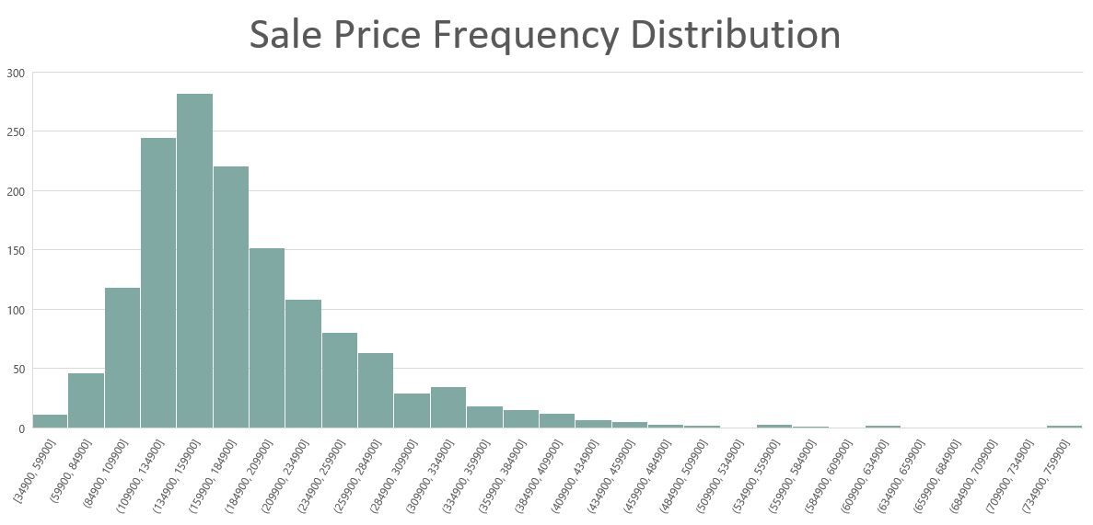
Notes:
This histogram of the sale prices means that the sample has normal distribution.

Slide 8
Descriptive Statistics
 | Total Rooms Above Ground | Year Built | Overall Quality | Sale Price
Mean | 6.517808219 | 1971.267808 | 6.099315068 | 180921.1959
Standard Error | 0.042538487 | 0.790446125 | 0.036194674 | 2079.105324
Median | 6 | 1973 | 6 | 163000
Mode | 6 | 2006 | 5 | 140000
Standard Deviation | 1.625393291 | 30.20290404 | 1.382996547 | 79442.50288
Sample Variance | 2.641903349 | 912.2154126 | 1.912679448 | 6311111264
Kurtosis | 0.880761566 | -0.439551942 | 0.096292778 | 6.53628186
Skewness | 0.676340836 | -0.613461172 | 0.216943928 | 1.88287576
Range | 12 | 138 | 9 | 720100
Minimum | 2 | 1872 | 1 | 34900
Maximum | 14 | 2010 | 10 | 755000
Sum | 9516 | 2878051 | 8905 | 264144946
Count | 1460 | 1460 | 1460 | 1460

Slide 9
Methods
Excel Data Analysis Toolpak
Descriptive Statistics
Correlations between variables and sale price
Hypothesis Testing – two-sample assuming unequal variances
Confidence Interval Calculation
Visualizations – charts, tables

Slide 10
Analysis Results
Below are the factors from my hypothesis along with their level of impact on the sale price, sorted by correlation.
Type of Correlation | Factor | Correlation
High Impact | Overall Quality | 0.790981601
 | Above Ground Living Area | 0.708624478
 | Garage Cars | 0.640409197
 | Total Baths | 0.631731068
 | Total Rooms Above Ground | 0.533723156
 | Year Built | 0.522897333
 | Fireplaces | 0.466928837
Low Impact | Lot Area | 0.263843354
 | Bedrooms Above Ground | 0.168213154
No impact | Overall Condition | -0.077855894
Notes:
Neighborhood is a categorical variable so correlation could not be tested.
Note the low impact factors.

Slide 11
Analysis Results
Top 3 Neighborhoods:
Northridge
Northridge Heights
Stone Brook
Homes in the Northridge neighborhood have the highest sale price on average.

Slide 12
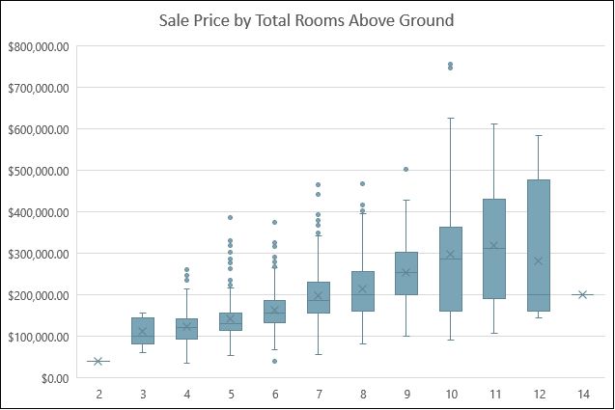
Total Rooms Above Ground
Analysis results: reject null hypothesis
Correlation: 0.534
T-tests:
Ho: μ1 - μ2 = 0 Ha: μ1 - μ2 ≠ 0
Separated by two groups: Total rooms <7 and Total rooms ≥7
P-value: 1.0968E-63 (<0.05)
Confidence interval: At the 95% confidence level, the difference of means (70,849) is between 63,174 and 78,523.
Notes:
The more rooms the house has above ground, the higher the mean sale price.

Slide 13
Year Built
Analysis results: reject null hypothesis
Correlation: 0.523
T-tests:
Ho: μ1 - μ2 = 0 Ha: μ1 - μ2 ≠ 0
Separated by two groups: Year Built <1971 and Year Built ≥1971
P-value: 1.19022E-89 (<0.05)
Confidence interval: At the 95% confidence level, the difference of means (77,008) is between 70,081 and 83,936.
Notes:
The newer the construction date of the house, the higher the mean sale price.

Slide 14
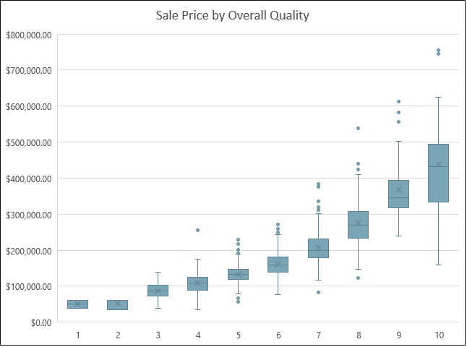
Overall Quality
Analysis results: reject null hypothesis
Correlation: 0.79
T-tests:
Ho: μ1 - μ2 = 0 Ha: μ1 - μ2 ≠ 0
Separated by two groups: Overall quality <6 and overall quality ≥6
P-value: 5.9183E-145 (<0.05)
Confidence interval: At the 95% confidence level, the difference of means (87,549) is between 81,678 and 93,420.
Notes:
The higher quality of the house, the higher the mean sale price.

Slide 15
Recommendations
Focus on the following factors when investing in mortgage-backed securities:
Overall Quality
Above Ground Living Area
Garage Car Capacity
Total Baths
Total Rooms Above Ground
Year Built
Number of Fireplaces
Neighborhood

Slide 16
Recommendations
Lot area and number of bedrooms have minimal impact on sale price
Overall condition has NO effect on sale price
Practical recommendations:
For investors:
Invest in newer-built homes in the Northridge neighborhood with a large garage and at least 1 fireplace
Prioritize homes with more rooms and larger living areas rather than homes with a large lot area
Prioritize homes with many bathrooms rather than many bedrooms
Focus on excellent quality homes rather than homes in good condition
For homebuyers on a budget:
Even if you don’t have a high budget when home shopping, you may still find an affordable home with a relatively lot area and in excellent condition since sale price isn’t significantly driven by these factors

Slide 17

QUESTIONS?

